Slide 1
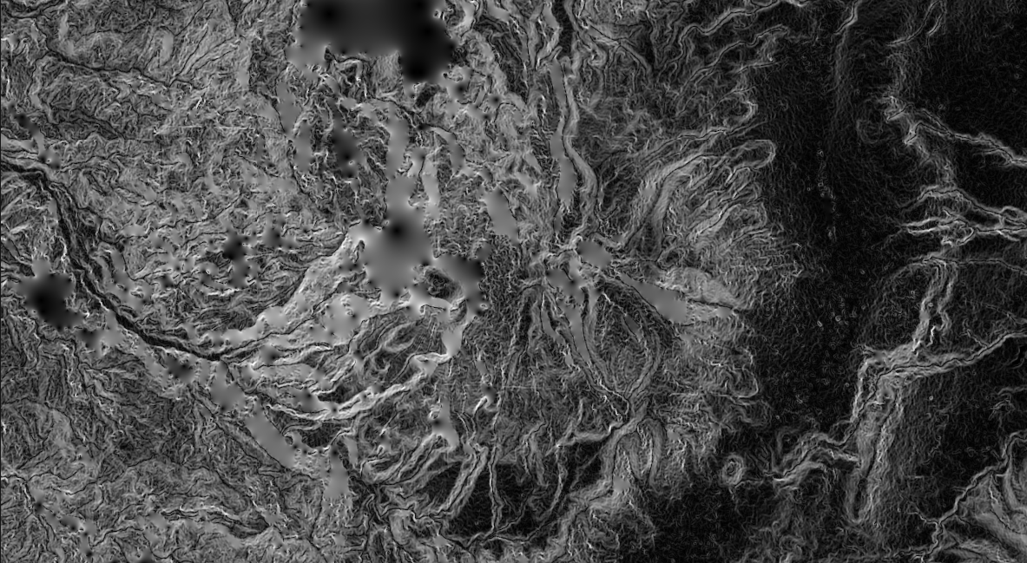
GIS for Geoscientists Session 3: Intermediate GIS
Presented by Nicholas Barber, 2nd Year PhD Student at the University of Cambridge, U.K.
ndb38@cam.ac.uk | www.volcannick.com | https://github.com/ndb38 | Twitter @volcannick

Slide 2
Course Structure
Today: Session 1 – Principles and Motivation for GIS in the Geosciences
Why GIS?
Principles of GIS
Getting acquainted with Quantum GIS
Tuesday November 10th: Session 2 – Beginner GIS Exercises
Tour of Interface
Guagua Pichincha Hazard Assessment
Friday November 13th: Session 3 – Intermediate GIS Exercises
Finishing up from last week
Importing raw data
Spatial Analysis
Interpolation
Data Management
Advanced formatting
Thursday November 17th: Advanced GIS Exercises (Work in Progress)
Geostatistics
Python
Models
Databases
Q&A

Slide 3
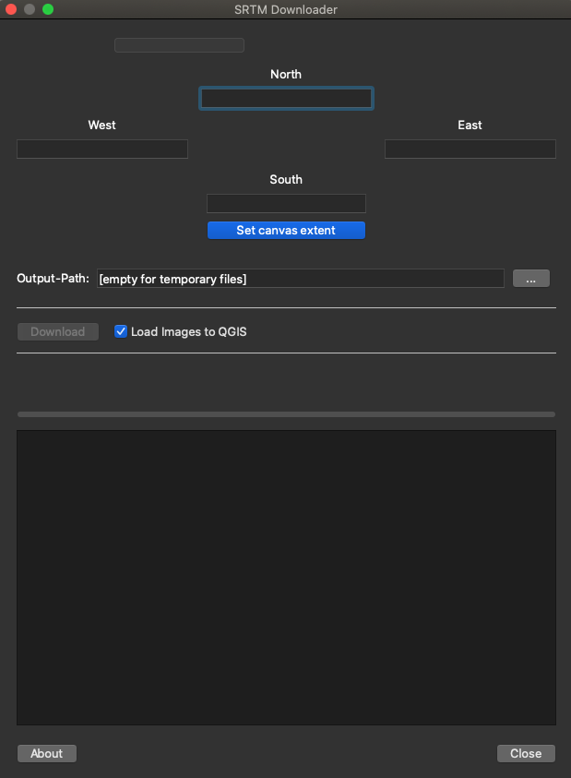
Notes for Today
NEWLY FOUND PLUGIN: SRTM Downloader
Need NASA EarthData Account
Doesn’t replace USGS Earth Explorer
Wednesday 1-1 Tutorial Sessions: Sign Up Open!!
This course has mainly been me talking – this is the chance for us to interact and for me to help you with any GIS topic that crosses your mind!
Sign Up Link: https://doodle.com/meetme/qc/iFKktdhLst

Slide 4
Previous Sessions Demonstration:
Planning a project
Finding Data
Defining CRS/PCS
Initial Import + Projection
Georeferencing Images
Tracing Basemaps
Analysis: Geoprocessing, Statistics, Attributes
Visualization and Symbology
Layout Design <<<< TODAY

Slide 5
Today’s Demonstration
What It Won’t Cover
Advanced Cartography (layout Manager)
LANDSAT Mineral Exploration
Too big a topic to cover in a 2-hour course ☹
Python in QGIS **in great detail**
I will show functionality, but once you know the basics, the details are self-explanatory

Slide 6
Today’s Demonstration
What It Won’t Cover
Advanced Cartography (layout Manager)
LANDSAT Mineral Epxloration
Too big a topic to cover in a 2 hour course
Python in QGIS **in great detail**
I will show functionality, but once you know the basics, the details are self-explanatory
What It Will Cover
**Layout Management and Map Creation**
Multiple Data Types Handling/Conversion
CSV + Raster Manipulation
Geostatistics
Raster Statistics + Zonal Statistics
Advanced Formatting + Symbology
DEM Visualization
Web Database Connections
Basics of Python in QGIS

Slide 7
Finishing Up From Session 2: Layout
Elements we want:
Main Map
Regional Inset Map
Legend
North Arrow
Scale bar
Grid
Labels for important features
Text box summarizing findings
Thigs to keep in mind:
Map Scale
Locking of display
Legend items
Aesthetic value

Slide 8
Let’s Get to It!
Section 2: Advanced Formatting
Line Symbology
Draw Effects
Heatmaps
Raster Viz.
3D Viewer
Section 3: Final Topics
Spatial Database Connections
Basics of Python
Section 1: Advanced Analysis
Exercise 2: Fluid Geochemistry of G.P.
Importing CSVs
Spatial Joins
Interpolating Point Shapefiles
Exercise 3: Landslide Risk near Quito
Raster Statistics
Rasterizing a Shapefile
Raster Calculator
Zonal Statistics
5 Minute break?

Slide 9
Session 3, Section 1
Handling Difficult Data Imports, Spatial Joins, Interpolating between Points, Raster Calculator, Spatial Statistics

Slide 10
Outline of Today’s Activity
Exercise #2
We want to know the chemistry of the fluids measured at G.P. Are there hotspots of high SO4 activity?
Requires:
Importing known geochemical data.
Georeferencing 2 new maps
Importing a dataset with no lat/long information
Creating new features
Performing a spatial join
Interpolating to find hotpots
Exercise #3
Landslide Risk example
Importing precipitation data
Calculating Raster Slope
Rasterize rainfall
Use raster calculator

Slide 11
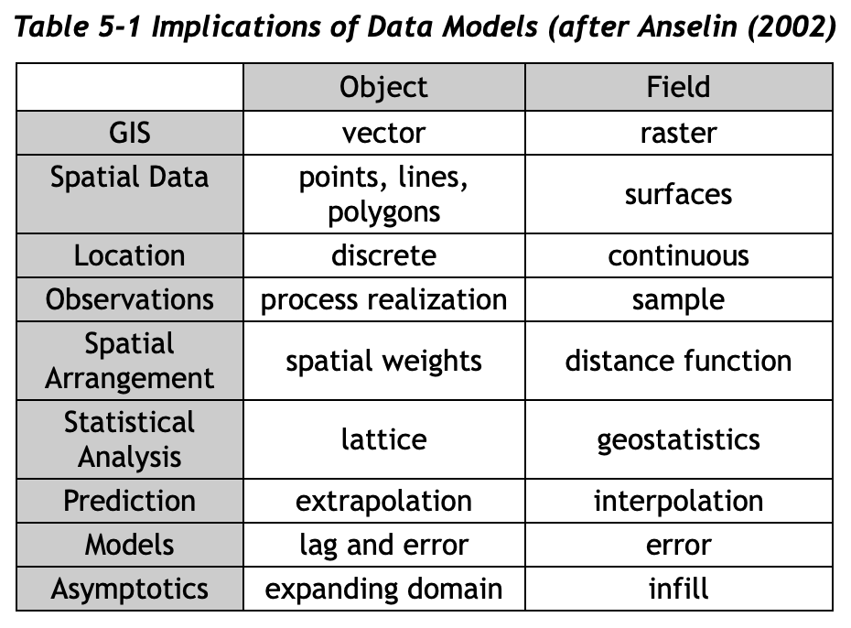
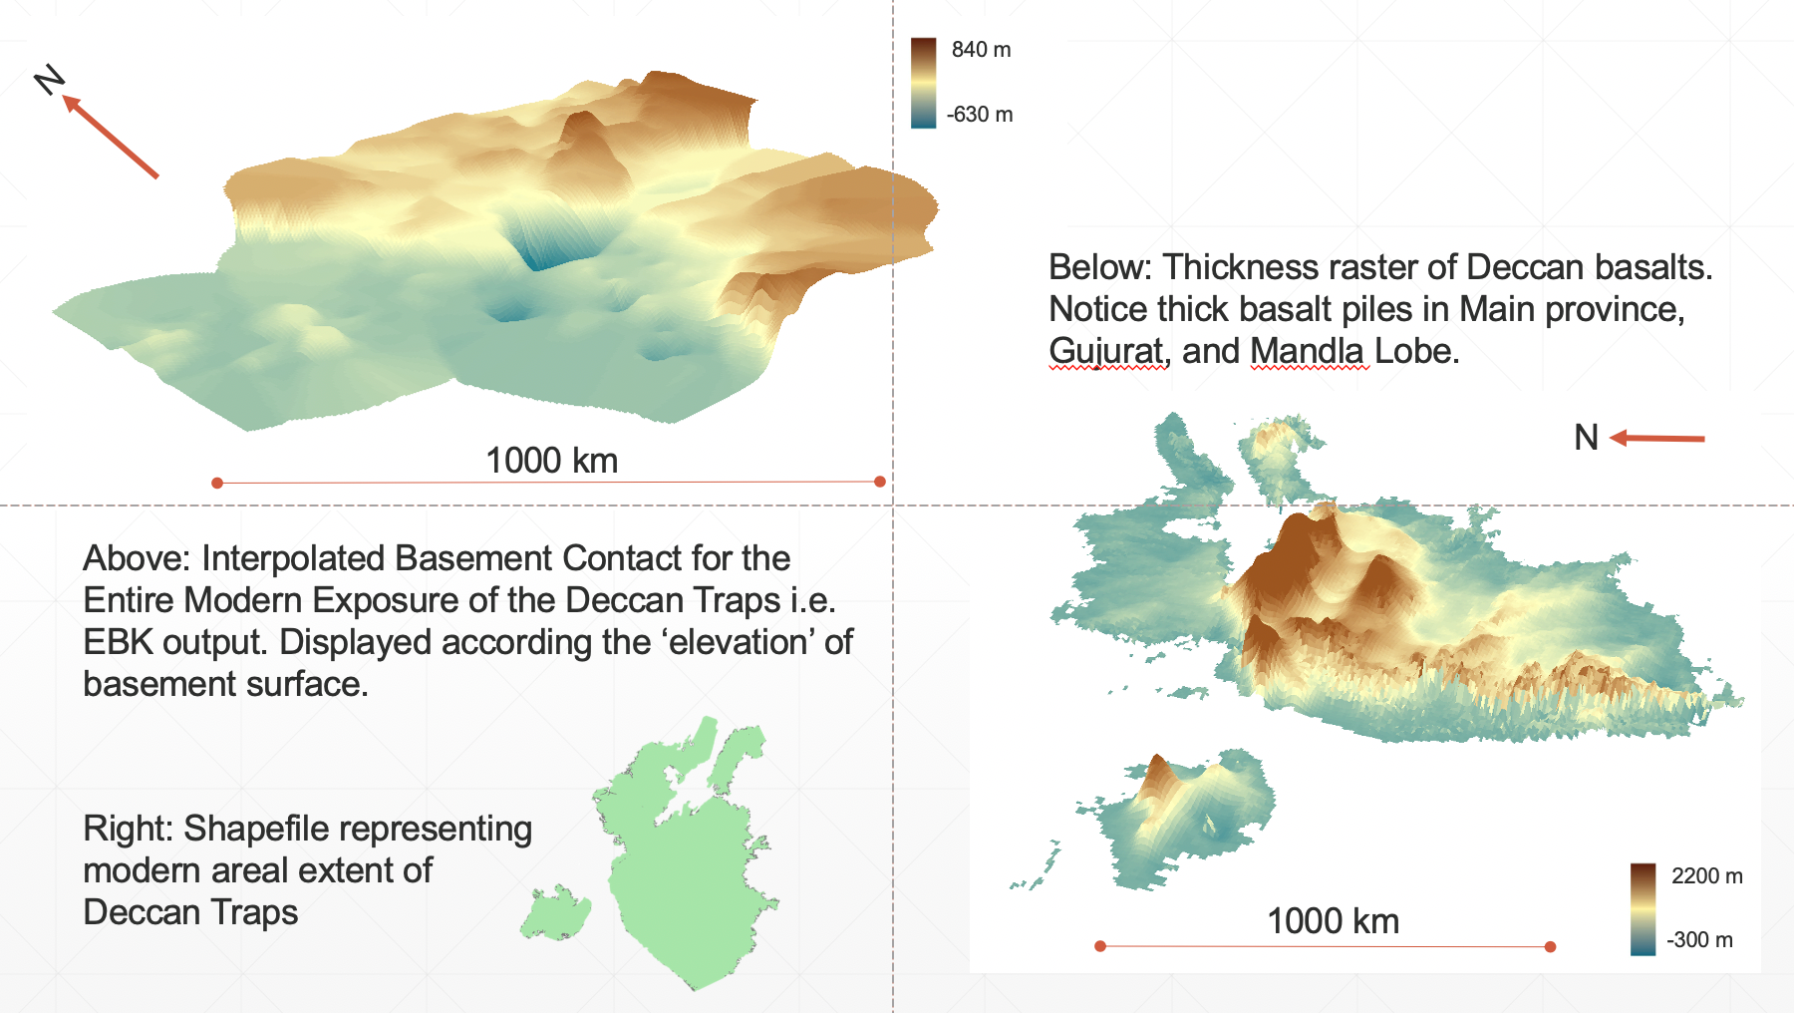
Geostatistics
Free AMAZING resource: https://www.spatialanalysisonline.com/HTML/index.html
One key feature of spatial statistics: because of spatial autocorrelation, data with a spatial dimension violate classical statistical assumption of independence
Independence – in probability theory, occurrence of event does not affect the probability of occurrence of another
Requires different approach to statistics and analysis
Special geostatistical operations: Inverse Distance Weighting (IDW), Kriging, Moran’s I coefficient
My Deccan work: Empirical Bayesian Kriging (EBK) >>>>

Slide 12
Section 2

Slide 13


Slide 14
Section 3

Slide 15
PyQGIS Resources
Beginner friendly tutorial: https://anitagraser.com/pyqgis-101-introduction-to-qgis-python-programming-for-non-programmers/
PyQGIS Official Cookbook: https://docs.qgis.org/testing/en/docs/pyqgis_developer_cookbook/
Learn Python in QGIS in a Day: https://courses.spatialthoughts.com/pyqgis-in-a-day.html

Slide 16
Final Thoughts

Slide 17
My goals at the start:
Highlight what GIS can do for geoscientists
Outline the key principles of a geographic information system
Providing a fully guided GIS workflow template
Identify key areas of growth for GIS in geoscience research

Slide 18
If you take nothing else away from this workshop….
GIS is a helpful tool in your workflow if you have data with a spatial dimension
GIS software lets you store, collect, analyze, and share spatial data
Modern GIS platforms like ArcMap and QGIS are all around workhorses – essential to tasks like spatial modeling, database management, cartography, geodesy, data visualization, hazard mitigation, and story telling
Learning the capabilities of GIS is acquired from repeated, often frustrating, trial and error with the hundreds of built-in tools
Studies should be designed with the GIS end user in mind!!!

